Slide 1
Hotel booking project
Content
Problem Definition.
Hotel Booking Dataset.
Descriptive Statistics.
Visualization Techniques.

Slide 2
Team members
Name | ID
Youssef Ahmed | 20180336
Salah Mohamed | 20180138
Mustafa Sayed | 20180277
Mohamed Hany | 20180242

Slide 3
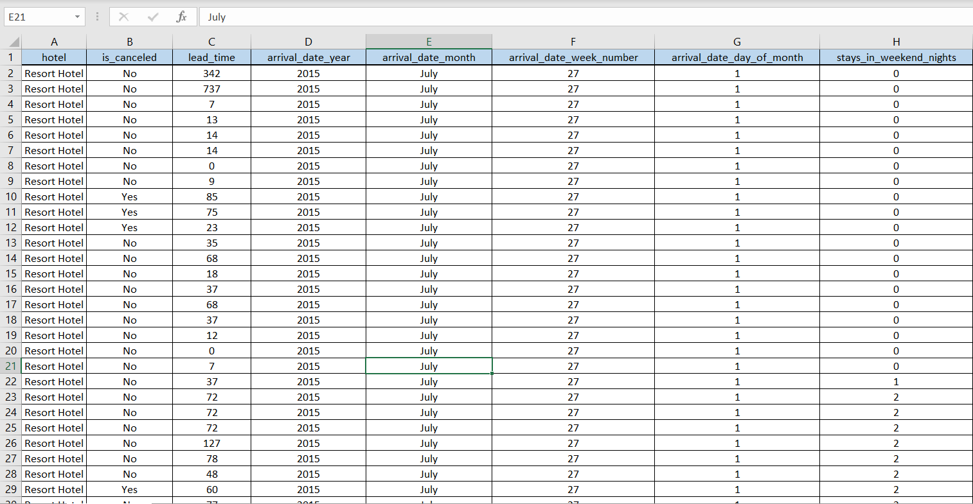
Problem definition

Slide 4
Problem definition
In this project our main purpose is to determine which type of hotels need more attention either from the government or investors, based on the total number of reservations all over the year in different seasons.
Here we mean by needing more attention that we want to determine which hotels in which season we need to invest in to make sure that they’re more comfort to make tourists feel the convenience and reliable to represent our country to foreigners.
This data set contains booking information for city & resort hotels, and includes information such as when the booking was made, length of residence, the number of adults, children, and/or babies, and the number of available parking spaces, etc.
All personally identifying information has been removed from the data.

Slide 5
Attribute
Is_canceled: Value indicating if the booking was cancelled (Yes) or not (No)
Lead_time: Number of days that elapsed between the entering date of the booking into the PMS and the arrival date
Arrival_date_year: Year of arrival date
Arrival_date_month: Month of arrival date
Arrival_date_week_number: Week number of year for arrival date
Arrival_date_day_of_month: Day of arrival date

Slide 6
Attribute
stays_in_weekend_nights_: Number of weekend nights (Saturday or Sunday) the guest stayed or booked to stay at the hotel
stays_in_week_nights: Number of week nights (Monday to Friday) the guest stayed or booked to stay at the hotel
Adults: Number of adults
Children: Number of children
Babies: Number of babies
Meal: Type of meal booked. Categories are presented in standard hospitality meal packages: Undefined/SC – no meal

Slide 7
Attribute
Country: Country of origin. Categories are represented in the ISO 3155–3:2013 format
market_segment: Market segment designation. In categories, the term “TA” means “Travel Agents” and “TO” means “Tour Operators”
distribution_channel: Booking distribution channel. The term “TA” means “Travel Agents” and “TO” means “Tour Operators”
is_repeated_guest: Value indicating if the booking name was from a repeated guest (Yes) or not (No)
previous_bookings_canceled: Number of previous bookings that were cancelled by the customer prior to the current booking

Slide 8
Attribute
reserved_room_type: Code of room type reserved. Code is presented instead of designation for anonymity reasons.
assigned_room_type: Code for the type of room assigned to the booking. Sometimes the assigned room type differs from the reserved room type due
booking_changes: Number of changes/amendments made to the booking from the moment the booking was entered on the PMS
deposit_type: Indication on if the customer made a deposit to guarantee the booking. This variable can assume three categories: No
Agent: ID of the travel agency that made the booking
Company: ID of the company/entity that made the booking or responsible for paying the booking. ID is presented instead of designation for

Slide 9
Attribute
days_in_waiting_list: Number of days the booking was in the waiting list before it was confirmed to the customer
customer_type: Type of booking, assuming one of four categories: Contract - when the booking has an allotment or other type of
Adr: Average Daily Rate as defined by dividing the sum of all lodging transactions by the total number of staying nights
required_car_parking_spaces: Number of car parking spaces required by the customer
total_of_special_requests: Number of special requests made by the customer (e.g. twin bed or high floor)
reservation_status: Reservation last status, assuming one of three categories: Canceled – booking was canceled by the customer; Check-Out – customer has checked
reservation_status_date: Date at which the last status was set. This variable can be used in conjunction with the ReservationStatus to

Slide 10
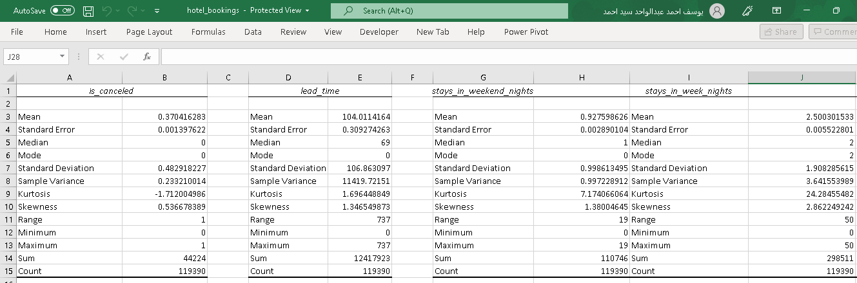
Descriptive statistics

Slide 11
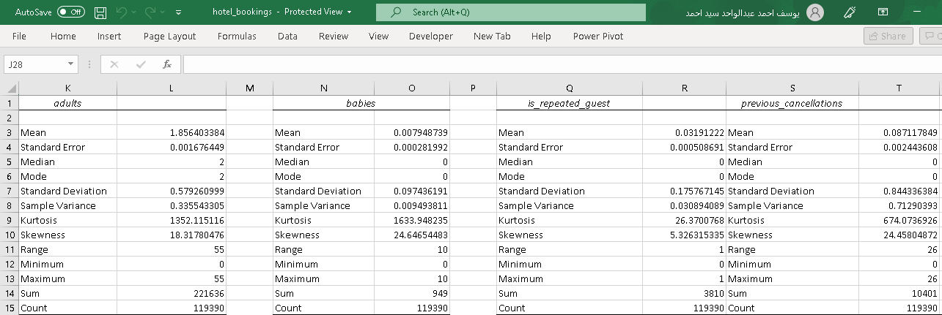
Descriptive statistics

Slide 12
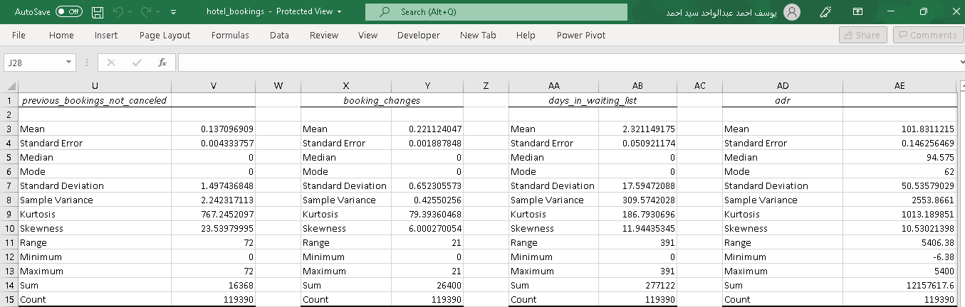
Descriptive statistics

Slide 13
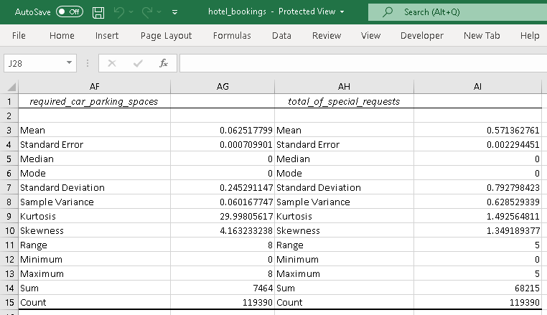
Descriptive statistics

Slide 14
Visualization techniques

Slide 15
Visualization techniques

Slide 16
Visualization techniques

Slide 17
Visualization techniques

Slide 18
Visualization techniques

Slide 19
Visualization techniques

Slide 20
Visualization techniques

Slide 21
Visualization techniques

Slide 22
Visualization techniques

Slide 23
Visualization techniques

Slide 24
Visualization techniques

Slide 25
Visualization techniques

Slide 26
Visualization techniques

Slide 27
Visualization techniques

